Slide 1
Managing a Database Migration Project – Best Practices and Customer Experiences
Blair Layton
Business Development Manager
Database Services

Slide 2
What to Expect from the Session
Database Migration Basics
AWS Database Migration Service Overview
AWS Schema Conversion Tool Overview
When to use DMS and SCT
Introduction to the AWS Migration Framework
AWS Migration Framework – Readiness and Planning
AWS Migration Framework – Activate
AWS Migration Framework – Execute
AWS Migration Framework – Optimize
Hints and Tips – Lessons from the Trenches
Database Migration Effort
Q&A!

Slide 3
Recap: Database Migration Basics

Slide 4
Customers Want to Migrate to AWS, but…
They can’t afford long periods of application downtime
Tools that enable minimal downtime are expensive
It seems too complex and expensive to migrate
They still need a copy of the data on-premise
They want to migrate to an open source database
Sending large volumes of data to AWS requires an expensive international network link
They don’t have the skills inside their organization

Slide 5
Traditional Approach to Migrate to AWS
Create your AWS account
Setup your Virtual Private Cloud (VPC) in AWS
Connect to AWS with a VPN or Direct Connect
Shutdown and backup your database
Transmit the backup to S3
Configure an EC2 instance with the DB software
Restore the backup
Configure EC2 instances for the application
Switch the users to use AWS

Slide 6
Traditional Approach to Migrate to AWS
Create your AWS account
Setup your Virtual Private Cloud (VPC) in AWS
Connect to AWS with a VPN or Direct Connect
Shutdown and backup your database
Transmit the backup to S3
Configure an EC2 instance with the DB software
Restore the backup
Configure EC2 instances for the application
Switch the users to use AWS
Steps 4-9 could take a week or more!

Slide 7
Now There is a Better Way!

Slide 8
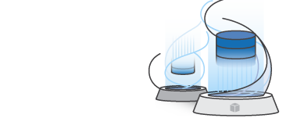

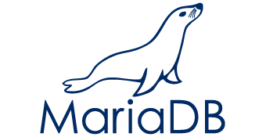
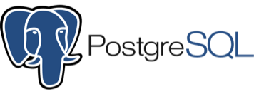

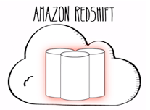
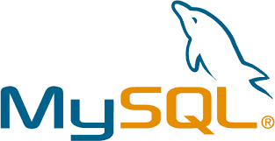
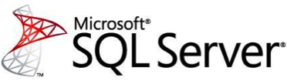

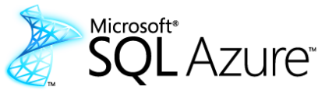
AWS Database Migration Service (AWS DMS)
DMS migrates databases to AWS easily and securely with minimal downtime. It can migrate your data to and from most widely used commercial and open-source databases.
Amazon Aurora
Notes:
And then we introduce the service….
So it was with all these factors in mind that we developed the database migration service. We designed it to be simple - you can get started in less than ten minutes. We designed it to enable near-zero-downtime migration. And we designed it to be a kind of replication Swiss army knife. To replicate data between on-premises systems, RDS, EC2, and across database engine type.
Reiterate what engines are supported + CDC

Slide 9
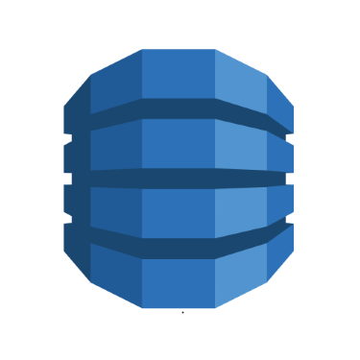


New NoSQL support
Migrate to AWS
Move between NoSQL and SQL
Move from MongoDB to Amazon DynamoDB
Move from MongoDB to relational db’s
Change technologies
DynamoDB
DynamoDB
RDS
Amazon Aurora
Notes:
Recently added support for NoSQL databases using DMS
For Mongo Two modes:
Document mode > JSON data becomes a single column in a target table
Table mode > DMS scans the Mongo documents and creates a set of all the keys and types to use a columns in a target table
For Dynamo:
DMS supports the scalar data types in Dynamo
Use mapping rules to define record to record or record to document mappings for relational sources
Also mention S3

Slide 10
New Support for S3 as a Source and Target
Extract Data from any supported DMS source to S3 and to any DMS target
Amazon Aurora
S3 Bucket
DynamoDB
S3 Bucket
Amazon Aurora

Slide 11

Keep Your Apps Running During the Migration
AWS
Database Migration Service
Customer
Premises
VPN
AWS
Internet
Start a replication instance
Connect to source and target databases
Select tables, schemas, or databases
Let AWS DMS create tables, load data, and keep them in sync
Switch applications over to the target at your convenience
Application Users
Notes:
Using the AWS Database Migration Service to migrate data to AWS is simple.
Start by spinning up a replication instance in your AWS environment
Next, from within DMS, connect to both your source and target databases
Choose what data you want to migrate. DMS lets you migrate tables, schemas, or whole databases
Then sit back and let DMS do the rest. It creates the tables, loads the data, and best of all, keeps them synchronized for as long as you need
That replication capability, which keeps the source and target data in sync, allows customers to switch applications over to point to the AWS database at their leisure. DMS eliminates the need for high-stakes extended outages to migrate production data into the cloud. DMS provides a graceful switchover capability.
Additional Flow Information
Customer creates a replication instance in the AWS Management Console
Customer enters source and target database connection info (“endpoints”)
Customer creates a task to migrate data from source to target
Data from the source is copied to tables on the target (“bulk load”)
Changes to data on source are captured while the tables are loaded
Once bulk load is complete, buffered changes are applied to the target
Additional changes captured on the source are applied to the target until the task stopped or terminated

Slide 12
For less than $10 per TB!

Slide 13
My Database is Too Big!

Slide 14
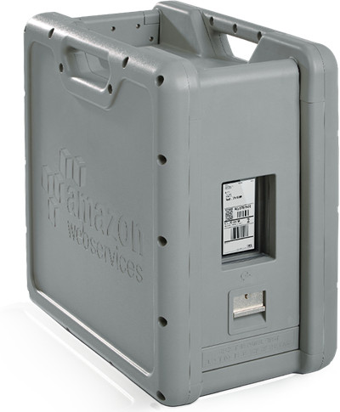
Data Ingestion with AWS
AWS Import/Export Disk – Ship your hard disks to AWS
AWS Import/Export Snowball – A secure storage appliance with up to 80 TB that AWS ships to you
Amazon S3 Transfer Acceleration – Use AWS Edge Locations nearest to you to transfer data on Amazon’s optimized network up to 300% faster. You only need to pay for a local network connection!

Slide 15
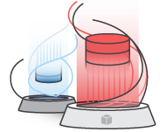
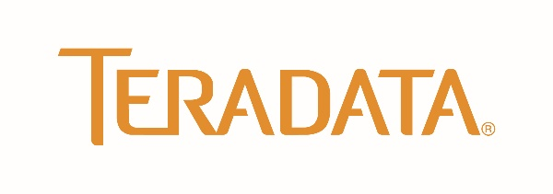


AWS Schema Conversion Tool (AWS SCT)
SCT helps automate many database schema and code conversion tasks when migrating between database engines or data warehouse engines
Amazon Aurora
Notes:
We used to talk about SCT as more of an afterthought than anything, but we are finding more and more people are looking to switch database engine and the link between the two products was not always clear
So what happens if you are converting from one database engine to another? Where does the magic happen? This is where the AWS Schema Conversion Tool steps in.
Relational and Data Warehouse schema conversion
Database Migration Assessment report for choosing the best target engine
Code browser that highlights places where manual edits are required
Secure connections to your databases with SSL
Cloud native code optimization
Start a DMS migration from SCT

Slide 16
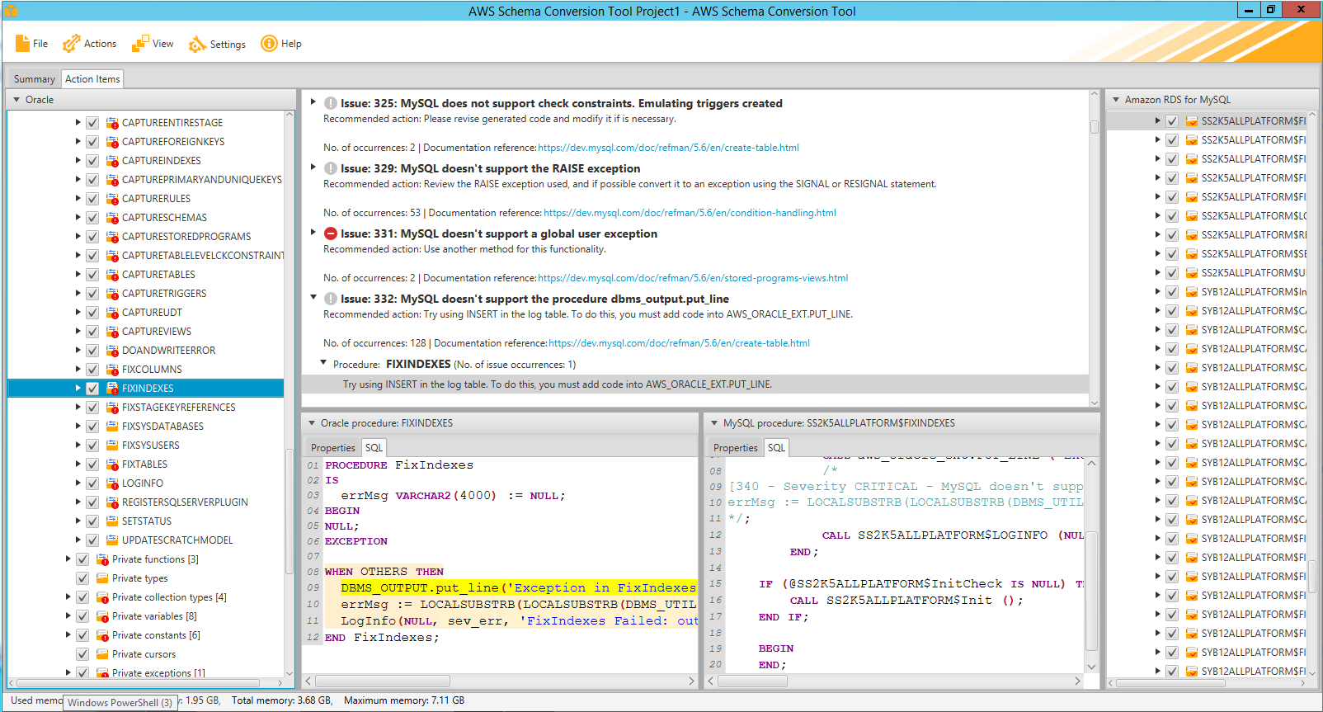
SCT Helps with Converting Tables, Views & Code
Sequences
User-Defined Types
Synonyms
Packages
Stored Procedures
Functions
Triggers
Schemas
Tables
Indexes
Views
Sort and distribution keys
Notes:
- Embedded SQL conversion
- Cloud native code optimization

Slide 17
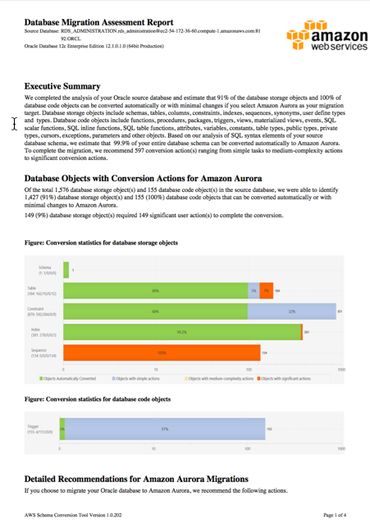
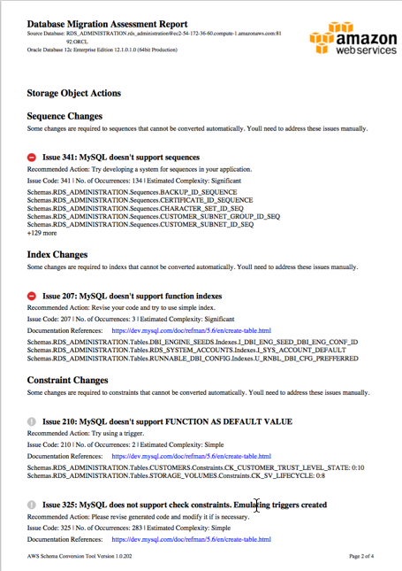
SCT can tell you how hard the migration will be
1. Connect SCT to Source and Target databases.
2. Run Assessment Report.
3. Read Executive Summary.
4. Follow detailed instructions.

Slide 18
Pricing and Terms and Conditions
$0
for software license
Pricing
Free software license
For active AWS customers with accounts in good standing
Allowed Use
Use SCT to migrate database schemas to Amazon RDS, Amazon Redshift, or Amazon EC2-based databases
To use SCT to migrate schemas to other destinations, contact for special pricing

Slide 19
When to use DMS and SCT?

Slide 20

Strengths and Focus Areas
DMS can act as a replication/migration Swiss Army knife, but is not a magic wand.
Use It
Heterogeneous migrations
Minimal downtime required
No native solution
Caution
Some tables with large LOBs
Complex data types
High load database
Don’t Use It
Native no downtime solution exists
Can take downtime + native
> 5 TB + slow Internet****
Notes:
**** SCT Extractors

Slide 21
Tools for Migration Project Phases
Phase | Service/Tool | Notes
Assessment | AWS Schema Conversion Tool | Reports on the database objects, complexity and types of migration issues
Schema Migration | AWS Schema Conversion Tool | Copies a schema or migrates a schema depending on whether it is a homogeneous or heterogeneous migrations
Data Migration | AWS Database Migration Service AWS Schema Conversion Tool | Bulk load and change data capture (CDC) options Extraction and load for large data warehouses, including AWS Snowball integration
Application Migration | AWS Schema Conversion Tool | SQL statement migration in application code
Data Validation | Manual | Count, Sum, or compare a hash of a query output
Functional Testing | Various Tools on Marketplace | Ensure the application runs as intended
Performance Testing | Various Tools on Marketplace | Ensure the application performance as intended

Slide 22
Tools for Migration Scenarios
Scenario | Example | Recommendation
Homogeneous migration to the same database version and edition | Migration of Oracle Database 11gR2 Enterprise Edition from on-premise to EC2 | Use the native replication technology to create a standby database and then failover to the standby database
Homogeneous migration to a different version | Migration of MySQL 5.5 to MySQL 5.7 | AWS Schema Conversion Tool and AWS Database Migration Service
Homogeneous migration to a different edition | Migration of SQL Server Enterprise Edition to Standard Edition | AWS Schema Conversion Tool and AWS Database Migration Service
Heterogeneous migration | Migration from Oracle Database to PostgreSQL | AWS Schema Conversion Tool and AWS Database Migration Service

Slide 23
That’s the tools, but how to manage migration projects?

Slide 24
Introducing the AWS Migration Framework

Slide 25
AWS Migration Framework
READINESS AND PLANNING
Project Control
Strategy (business driver)
Key Stakeholders and Team
Plan (Scope, Schedule, Resources)
Cost Estimation
Portfolio discovery
Migration plan
Operations Integration
Security
Notes:
The first part of the AWS Migration Framework is Readiness and Planning.
Readiness and Planning deals with understanding the business drivers, operational model and security requirements, mobilizing resources, creating a business case and performing discovery.
This step includes:
Setting up your project for success across multiple dimensions like strategy, stakeholders, people, planning, and cost estimation.
Additionally you complete the portfolio discovery, which is discovering the applications you have in your environment.
Then you develop a migration plan for those applications.
We talk about Operations Integration in this phase so that you think through how workloads are operated after migration.
Finally, you should create the foundational security capability to support the migration and ongoing operations once the migration is complete.
I will cover the Readiness and Planning phase of the framework in more detail in the following section.

Slide 26
AWS Migration Framework
READINESS AND PLANNING
Project Control
Strategy (business driver)
Key Stakeholders and Team
Plan (Scope, Schedule, Resources)
Cost Estimation
Portfolio discovery
Migration plan
Operations Integration
Security
ACTIVATE
Prioritized Backlog
Application groups
Migration strategy
Success criteria
Ops Integration – Foundation and Landing Zone (target zone setup)
Setup Factory (Tools, Teams, Processes)
Pilot Migration
Notes:
Next, we review the ACTIVATE phase.
Activate revolves around standing up a migration factory that can scale-in and out, creating a prioritized backlog of applications, and setting up the landing zone for your organisation
Landing zone refers to your AWS architecture, minimum shared services required, security and operations constructs.
What we are doing in this phase is taking the output from the Readiness and Planning phase, and then translating that into a “factory” that will enable you to execute on the output.
We are doing this by:
ONE – creating that backlog of applications, broken into groups, with a migration plan, and success criteria defined.
TWO – setting up the foundation for your AWS Landing Zone
THREE – setting up the tools, teams, and processes you require. Your team can be workload oriented or function oriented. What this means is that depending on the size of your organisation, you might choose to have a single team that works together on migrations workload by workload. Alternatively, you can work on migrations split by function… in this model different teams have different functions… for e.g. the Database resource working on Databases, the Storage person working on storage requirements, and so on.
FOUR – You do pilot migrations in this phase to ensure that you are on the right track

Slide 27
AWS Migration Framework
READINESS AND PLANNING
EXECUTE
Prioritized Backlog (PLAN)
Discover
Build
Integrate
Validate
Design
Cutover
Project Control
Strategy (business driver)
Key Stakeholders and Team
Plan (Scope, Schedule, Resources)
Cost Estimation
Portfolio discovery
Migration plan
Operations Integration
Security
ACTIVATE
Prioritized Backlog
Application groups
Migration strategy
Success criteria
Ops Integration – Foundation and Landing Zone (target zone setup)
Setup Factory (Tools, Teams, Processes)
Pilot Migration
Notes:
AFTER activate, we go into the execute phase.
Execute involves picking applications from the prioritized backlog of applications and iterating on the various activities including:
Performing a more detailed discovery of the application architecture as well as business and technical requirements
Designing the end state for the application. The end state refers to how this application would be architected on top of AWS.
Migrating or Building using an automated tool. This is the part where the infrastructure and application resources are deployed on AWS.
Integrating with any shared services that might be on AWS or in a hybrid model back on premise.
Testing using an automated tool OR in some cases you might require live-user testing as well, and
Performing cutover.
Then iterating this cycle over and over again for your backlog of applications.

Slide 28
AWS Migration Framework
READINESS AND PLANNING
EXECUTE
Prioritized Backlog (PLAN)
Discover
Build
Integrate
Validate
Design
Cutover
Project Control
Strategy (business driver)
Key Stakeholders and Team
Plan (Scope, Schedule, Resources)
Cost Estimation
Portfolio discovery
Migration plan
Operations Integration
Security
ACTIVATE
Prioritized Backlog
Application groups
Migration strategy
Success criteria
Ops Integration – Foundation and Landing Zone (target zone setup)
Setup Factory (Tools, Teams, Processes)
Pilot Migration
OPTIMIZE
Application optimization
Process optimization
Operational optimization
Cost optimization
Notes:
Optimize phase allows customers to tweak their application posture based on the 4 pillars of the well-architected framework. You can optimize the applications, the associated processes, operations and how much you are spending on them by doing activities like right-sizing.
All of the activities from activate onwards, may happen in parallel and in an iterative fashion.
In Summary: The cloud migration process does not have to follow the traditional waterfall approach. AWS strongly recommends that you use a continuous delivery methodology like Scrum to efficiently migrate applications to the AWS cloud.
In this iterative process, you create multiple sprints and add your applications to the backlog based on prioritization. Migration teams will pick up the applications from the ordered backlog and process them through the migration factory.
In the migration factory, each application goes through further discovery, analysis, planning, design, migration, integration, and validation. Once validation is complete, you will operate the application in the AWS cloud and optimize it for leveraging the agility, security, and cost efficiency provided by the AWS cloud.

Slide 29
AWS Migration Framework- Readiness and Planning

Slide 30
AWS Migration Framework - Readiness & Planning
READINESS AND PLANNING
Project Control focuses on ensuring there is a migration strategy in place that is supported by key stakeholders in the organisation. Additionally, we look at defining the team that will carry out the work, with associated timelines and cost estimations.
Sample decision points:
Who is the executive sponsor?
Are there any compelling events that will affect the migration strategy?
Do we have the right resources? How are they organized?
What are the timeframes we are working with?
Do we have the necessary budget?
Project Control
Strategy (business driver)
Key Stakeholders and Team
Plan (Scope, Schedule, Resources)
Cost Estimation
Portfolio discovery
Migration plan
Operations Integration
Security
Notes:
The very first thing you have to do when embarking on a significant project is to setup the Project Control. This spans:
Strategy
Stakeholder management
Planning, and
Costing
That is true for any significant project.
The intent of Project Control is that you understand what is the business driver behind these migrations. Doing so, allows IT to align with the business, and start to become an enabler for the business.
You want to identify who are the key stakeholders and who are the people who will be working on this project. For e.g. if the technology infrastructure team came up with a migration plan without getting the application stakeholders onboard… Then it will indeed be a difficult project to get off the ground. Similarly, you want to ensure that your project is properly staffed, and you have people with the right skills working on it.
Following which you would develop a plan with associated costing. It is really important at this point to make sure your work plan is setup to be Agile, delivering value quickly and in short cycles, with a focus on acceleration.

Slide 31
AWS Migration Framework - Readiness & Planning
Quickly understand which applications are Cloud Eligible, Cloud Friendly, or Cloud Native and then execute a deep dive analysis on just that subset of applications.
READINESS AND PLANNING
Project Control
Strategy (business driver)
Key Stakeholders and Team
Plan (Scope, Schedule, Resources)
Cost Estimation
Portfolio discovery
Migration plan
Operations Integration
Security
Notes:
Next comes Portfolio discovery.
Key activity of this phase is portfolio discovery and analysis
This is to review your application portfolio at a holistic level, and
Turn that analysis into a backlog for future phases
At the core of the discovery and planning activities you have the scope of the portfolio that is targeted for migration. Whether it’s a small subset of a portfolio or multiple data centers, the Enterprise must have a specific scope in mind before moving forward.
Then you need to get a gauge for how much data do you have around your IT estate and how accurate and relevant is the data. Often times the data is not useful or there is a low level of fidelity associated with it.
It is important to understand your Business Driver that may impact the prioritization of the applications that will be migrated –It could be de-risking assets (EOL, end of support, un-licensed assets), purely financial (need to be out of the data center or colo by X date), or have active roadmap for the applications and time to market is too slow on-prem.
Other points that we focus on are any technical constraints (unsupported OS, mainframes, etc…). Enterprise should then determine what the proper scoring weights should be to prioritize applications. They should then create the priroritized backlog of applications based on the discovered data and the agreed upon scoring mechanism.
That said, you should not get stuck into analysis paralysis at this stage. Start by quickly understanding which applications are Cloud Eligible, Cloud Friendly, or Cloud Native. Then execute a deep analysis on just that subset of applications.

Slide 32
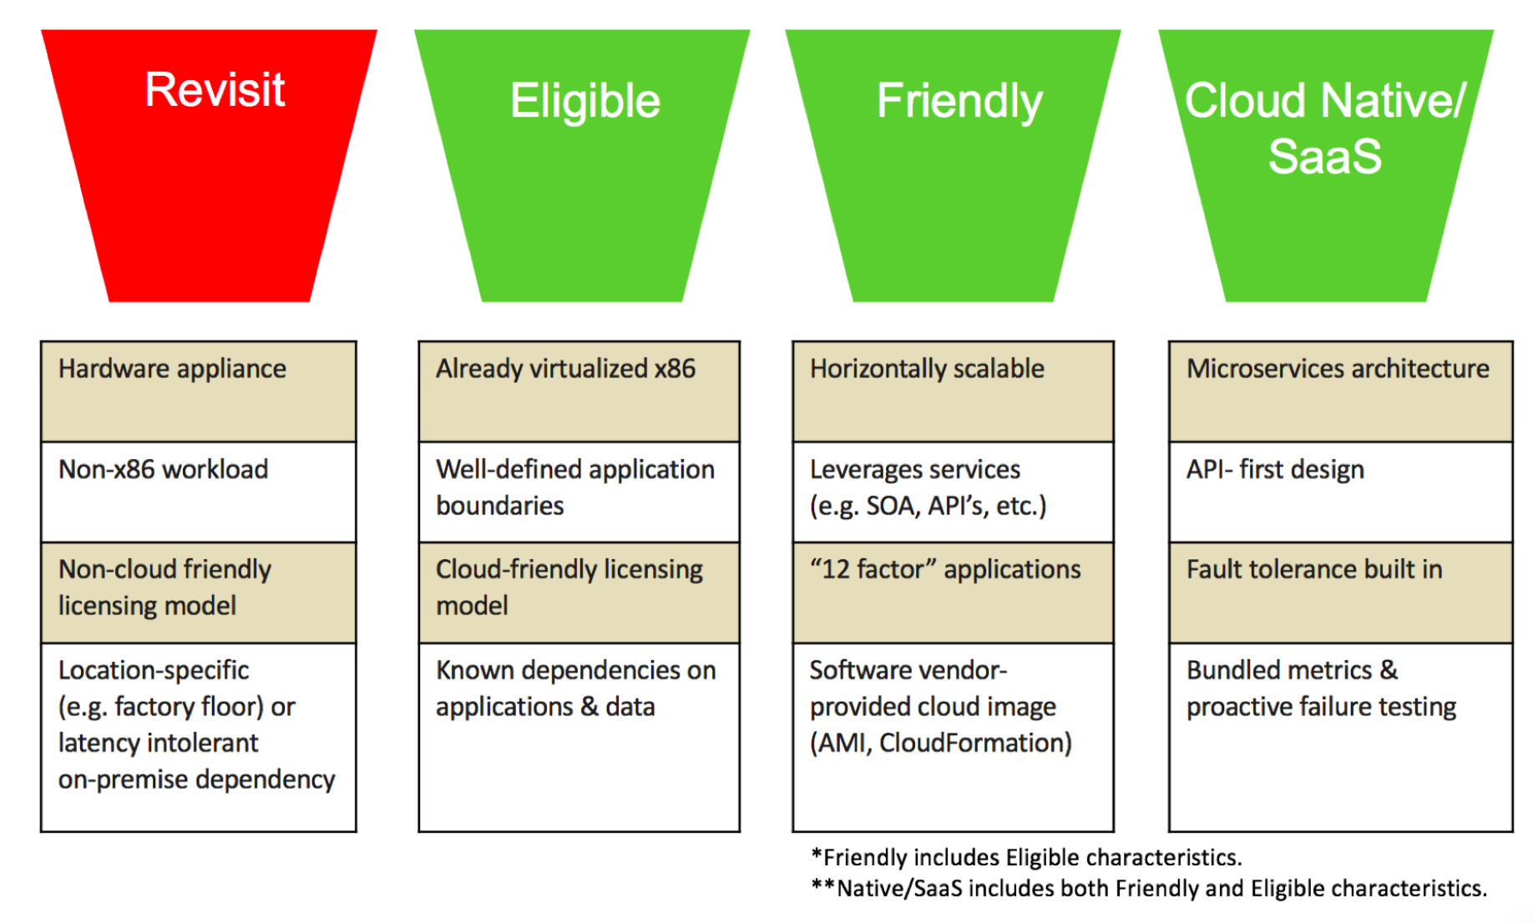
AWS Migration Framework - Readiness & Planning
Quickly understand which applications are Cloud Eligible, Cloud Friendly, or Cloud Native and then execute a dive deep analysis on just that subset of applications.
READINESS AND PLANNING
Project Control
Strategy (business driver)
Key Stakeholders and Team
Plan (Scope, Schedule, Resources)
Cost Estimation
Portfolio discovery
Migration plan
Operations Integration
Security
Notes:
On the screen, I have shown a simple method to bucket applications into Cloud Eligible, Cloud Friendly, Cloud Native, and those you want to revisit later.
Cloud Eligible applications are those that are already virtualised and on x86. They have well defined boundaries without that many dependencies or atleast known dependencies, and work on a Cloud friend licensing model.
Cloud friendly applications include the characteristics of Cloud Eligible applications. They are also horizontally scalable, and leverage services. They might also have an AMI provided by the software vendor.
Cloud Native applications include the characteristics of Cloud Eligible and Cloud Friendly. They also adopt a Microservices architecture and API-first design.
The Revisit bucket are the applications that you might want to revisit later. They are typically hardware appliances that don’t operate on x86 today. They might also have a non-cloud friendly licensing model, and have location-specific requirements.
After applications have been “bucketed” based on their characteristics, these applications should be prioritized into a backlog for migration teams to start the migration process to AWS immediately.
This just-in-time approach to feeding the backlog enables the migration teams to leverage their on-going migration experiences. The migration team can then provide validated insights back to the portfolio analysis team for more precise application selection during future iterations.

Slide 33
Application Assessment
What’s the business driver and intended ROI?
Who’s sponsoring the migration (business owner, C-level)?
Is it an ISV application? If so, does the ISV support the target?
What’s the maintenance window for the migration?
Is there any design documentation?
Are the original developers/DBAs still available?

Slide 34
It’s Not Just the Database!
Application code
Scripts and integration points
Backup and recovery
General management procedures
Monitoring
Notifications
Auditing
Tuning and Diagnostics
People!

Slide 35
Database Assessment
How many database objects (tables, triggers, SPs, users, etc.)?
How much data?
What’s the complexity of the SPs and triggers?
Are proprietary DB features used?
Are there non-standard or custom data types?
What character sets are used?
What time zone is used?
What’s the user authentication method?
What’s the licensing mechanism (cores, users, ULA etc.)

Slide 36
Application Technical Assessment
How is the DB accessed:
Individual SQL statements throughout the code?
Calls to an application data abstraction layer?
API calls?
Is ANSI SQL used where possible?
What’s the complexity of the SQL, e.g. analytics with many joins or simple CRUD?
How many lines of SQL are there?
How is application access controlled, e.g. LDAP, DB Users, etc.

Slide 37
AWS Migration Framework - Readiness & Planning
The 6Rs of migration planning
READINESS AND PLANNING
Project Control
Strategy (business driver)
Key Stakeholders and Team
Plan (Scope, Schedule, Resources)
Cost Estimation
Portfolio discovery
Migration plan
Operations Integration
Security
Notes:
This illustration depicts the various paths an application may take on it’s journey to the cloud. One takeaway is that there are some common activities that need to take place regardless of the path chosen. Namely, discovery, validation, integration and cutover or go-live.
Now, I am going to go through these 6 Rs in just a little bit of detail.
REHOSTING — Otherwise known as “lift-and-shift.”
We find that many early cloud projects gravitate toward net new development using cloud-native capabilities. However, in a large legacy migration scenario, where the organization is looking to scale its migration quickly to meet a business case, we find that the majority of applications are rehosted. GE Oil & Gas, for instance, found that, even without implementing any cloud optimizations, it could save roughly 30 percent of its costs by re-hosting.
Most rehosting can be automated with tools (e.g. AWS VM Import), although some customers prefer to do this manually as they learn how to apply their legacy systems to the new cloud platform.
We’ve also found that applications are easier to optimize/re-architect once they’re already running in the cloud. Partly because your organization will have developed better skills to do so, and partly because the hard part — migrating the application, data, and traffic — has already been done.
REPLATFORMING
Here you might make a few cloud (or other) optimizations in order to achieve some tangible benefit, but you aren’t otherwise changing the core architecture of the application. You may be looking to reduce the amount of time you spend managing database instances by migrating to a database-as-a-service platform like Amazon Relational Database Service (Amazon RDS), or migrating your application to a fully managed platform like Amazon Elastic Beanstalk.
REPURCHASING
We see repurchasing as a great way to accelerate your migrations. For e.g. you might move from a hardware appliance to an AWS Marketplace solution.
REFACTORING 4. Refactoring / Re-architecting —
This is where you architect and develop the application by using cloud-native features.
This is typically driven by a strong business need to add features, scale, or performance that would otherwise be difficult to achieve in the application’s existing environment.
RETIRE
Once you’ve discovered everything in your environment, you might ask each functional area who owns each application. We’ve found that as much as 10% (or even 20%) of an enterprise IT portfolio is no longer useful, and can simply be turned off. These savings can boost the business case, direct your team’s scarce attention to the things that people use, and lessen the surface area you have to secure.
RETAIN — Usually this means “revisit” or do nothing (for now).
This might be an appliance running on an hardware appliance or it is not running on x86. Or there might be other reasons why you might want to retain this application on-premise for now e.g. location specific requirements.
Understanding these 6Rs will help you understand the potential migration plans for your portfolio of applications.

Slide 38
AWS Migration Framework - Readiness & Planning
READINESS AND PLANNING
Operations Integration focuses on planning, guiding, and supporting an efficient progression of the operational model during the migration. This includes defining a desired ITSM state and support model that covers tools, people, and processes.
Sample decision points:
How will the execution of the migration factory impact normal operations?
Who are the support teams and partners that will interact with the cloud environments?
How will we scale operations in a hybrid or all-in model?
What is our BCP/ DR playbook?
How will we manage, monitor, patch, backup and recover databases in AWS?
Project Control
Strategy (business driver)
Key Stakeholders and Team
Plan (Scope, Schedule, Resources)
Cost Estimation
Portfolio discovery
Migration plan
Operations Integration
Security
Notes:
In the operations integration component of Readiness and Planning, we look at the ways in which the Enterprise will operate their workloads on AWS. This is more than just deciding what is the logging and monitoring strategy.
This is a holistic definition of the IT service management state and support model that covers people, processes, and tools. For e.g. you might have a set of tools that are used to perform certain tasks by a fixed set of people in your on-premise world… how does that change when you migrate your applications to AWS.
Defining this evolution of IT operations is covered in the Operations Integration phase of Readiness and Planning.
In this phase you are understanding how the migration factory affects normal operations. You might also consider questions like what is our Business Continuity and Disaster Recovery playbook following migration to AWS.

Slide 39
AWS Migration Framework - Readiness & Planning
READINESS AND PLANNING
Security focuses on helping customers build a structured approach that will accelerate the readiness for migration projects. This includes creating foundational security capability to support the migration and ongoing operations once the migration is complete.
Sample tasks:
Securing IAM users and groups
Creating managed IAM policies
Preparing account for monitoring and logging
Launching Security Baseline AWS CloudFormation templates
Configuring Amazon SNS notifications
Consider database license auditing
Determine database auditing requirements and log management
Determine database encryption requirements
Project Control
Strategy (business driver)
Key Stakeholders and Team
Plan (Scope, Schedule, Resources)
Cost Estimation
Portfolio discovery
Migration plan
Operations Integration
Security
Notes:
In the Security component of the Readiness and Planning phase, the Enterprise should define it’s required security posture, and determine how to implement it on AWS.
When you move your applications to AWS, we have a shared responsibility model with the customer.
AWS manages and controls the components from the host operating system and virtualization layer down to the physical security of the facilities in which the services operate, and AWS customers are responsible for building secure applications.
We provide a wide variety of best practices documents, encryption tools, and other guidance our customers can leverage in delivering application-level security measures. In addition, the AWS Partner Network offers hundreds of tools and features to help customers to meet their security objectives, ranging from network security, configuration management, access control, and data encryption.
I have listed some sample tasks that might happen during this phase. The intent is that you should build a structured approach that accelerates your readiness for migration projects.

Slide 40
Migration Readiness and Planning Outcomes
Migration business case
Skills/Center of Excellence
Security and compliance
Operating model
Platform landing zone
Discovery and planning
Migration plan

Slide 41
AWS Migration Framework -Activate

Slide 42
AWS Migration Framework - Activate
ACTIVATE
Determine your application priorities and group integrated applications together
Outline the success criteria for each application migration
Create your AWS landing zone (accounts, VPC, subnets, IAM roles, VPN/Direct Connect, etc.)
Configure DMS, SCT and other migration tools
Team creation
POC or pilot
Prioritized Backlog
Application groups
Migration strategy
Success criteria
Ops Integration – Foundation and Landing Zone (target zone setup)
Setup Factory (Tools, Teams, Processes)
Pilot Migration
Notes:
Next, we review the ACTIVATE phase.
Activate revolves around standing up a migration factory that can scale-in and out, creating a prioritized backlog of applications, and setting up the landing zone for your organisation
Landing zone refers to your AWS architecture, minimum shared services required, security and operations constructs.
What we are doing in this phase is taking the output from the Readiness and Planning phase, and then translating that into a “factory” that will enable you to execute on the output.
We are doing this by:
ONE – creating that backlog of applications, broken into groups, with a migration plan, and success criteria defined.
TWO – setting up the foundation for your AWS Landing Zone
THREE – setting up the tools, teams, and processes you require. Your team can be workload oriented or function oriented. What this means is that depending on the size of your organisation, you might choose to have a single team that works together on migrations workload by workload. Alternatively, you can work on migrations split by function… in this model different teams have different functions… for e.g. the Database resource working on Databases, the Storage person working on storage requirements, and so on.
FOUR – You do pilot migrations in this phase to ensure that you are on the right track

Slide 43
Building a Migration Team
Application architect/developer: Understands the application and can identify what components are important, complex, redundant, etc.
Source DBA: Knows the database design, schema, features used and what must be migrated to the target.
Target DBA: An expert in the target database to help map features from the source DB with the Source DBA. Ideally this DBA has experience in the source DB too.
AWS Solution Architect: Determines the correct target architecture for the application and database in AWS and is familiar with DMS/SCT.
Application/Database Developers: Either from the customer or the partner who will help make the required changes to the stored procedures, triggers and application code.

Slide 44
Hiring and Developing Talent
New skills are needed for the target DB and often AWS if migrating from on-premises
Develop training plans for existing employees
Hire in required skills if necessary
Retrain, redeploy or make people redundant who’s skills are no long relevant

Slide 45
Pilot/POC
Choose a reasonably complex module/component to migrate to validate your assumptions in the Activate phase
You should:
Obtain more accurate migration assessments
Determine what can be automated
Learn how the migration tools behave (limitations, bugs, improvements needed)
Learn what skills are missing from your team

Slide 46
AWS Migration Framework -Execute

Slide 47
AWS Migration Framework - Execute
EXECUTE
Always have a back up plan!
Execute the migration plan according to lessons from Pilot/POC
Typically the same amount of time to migrate the DB as to migrate the application (assuming DAL)
Determine how you will cutover
Parallel run: expensive and difficult, typically FSI/Telco only
Minimal downtime: DMS+CDC
Large maintenance window: application and data verification before go live
Discover
Build
Integrate
Validate
Design
Cutover
Notes:
AFTER activate, we go into the execute phase.
Execute involves picking applications from the prioritized backlog of applications and iterating on the various activities including:
Performing a more detailed discovery of the application architecture as well as business and technical requirements
Designing the end state for the application. The end state refers to how this application would be architected on top of AWS.
Migrating or Building using an automated tool. This is the part where the infrastructure and application resources are deployed on AWS.
Integrating with any shared services that might be on AWS or in a hybrid model back on premise.
Testing using an automated tool OR in some cases you might require live-user testing as well, and
Performing cutover.
Then iterating this cycle over and over again for your backlog of applications.

Slide 48
AWS Migration Framework -Optimize

Slide 49
AWS Migration Framework - Optimize
OPTIMIZE
DMS instance and task optimization
Database tuning
Database instance right sizing
Application tuning
Application instance right sizing
Use EC2 and RDS stop/start to optimize costs
Purchase reserved instances and use spot instances
Look for contention and evaluate caching, NoSQL, federation and adoption of a microservices strategy
Perform HA/DR scenarios and optimize the use of AWS managed services to help, e.g. RDS MAZ, Auto-scaling
Application optimization
Process optimization
Operational optimization
Cost optimization

Slide 50
Hint & Tips – Lessons From the Trenches

Slide 51
Migrations are Hard!
You can’t just run the tools & assume everything will work
Read the documentation – there are limitations
Understand your source, target and data
Plan your migrations just like a new development project
Be prepared to test your migration strategy and iterate
Ask for help from AWS solution architects, Professional Services and Support
Provide feedback on your experience so we can improve our tools and services
Use migration partners

Slide 52
Things to remember
DMS only creates tables and Primary Keys -> Use SCT!
In addition PKs will not have the same names as in the source
Enable CloudWatch Logs – This is not enabled by default
Security Group is default for VPC ( can change after creation)
If you restart a task, any tables that have not completed their initial load are restarted.
Supplying Extra Connection Attributes can alter how the migration task operates.
May need to provide a transformation rule for case names
Convert from Uppercase to Lowercase when Migrating Oracle to PostgreSQL

Slide 53
Things to remember – Cont.
Encrypted data can cause problems even between the same databases if keys need to be transferred and managed
Some migration methods don’t support encryption
Engineered systems such as Exadata and Oracle Database Appliances may have different behavior and migration issues than stand alone system
DMS writes to the source database, so some DBAs will complain
Test your network throughput. One customer had 6TB on a 300 Mbps link that they calculated at 3.5 days, but it took 7!
Plan ahead: opening firewall ports, configuring networks and changes to outsourced systems can take weeks

Slide 54
Things to remember – Cont.
Full LOB Mode is the default, however you should probably use Limited LOB mode
If a table has LOBs using “Limited LOB mode” and setting the MAX LOB size will be faster then using “Full LOB Mode”
Reduce Contention on your target
Turn off Logging
Run in Single AZ
Use a larger DMS Instance, DMS relies heavily on CPU due to conversions
Source Types → AWS Types → Target Types
Beware of unsupported data types

Slide 55
Things to remember – Cont.
Split the load if required by using multiple tasks and possibly multiple DMS instances
Monitor CPU load on the DMS instance and network bandwidth
Don’t use T2 instances for major production workloads!
Remember transaction boundaries if planning to capture changes.
Also look at using a read replica or standby as the load source
Remember to do integration tests, especially with on-prem resources
Have a look at our best practices document:
https://d0.awsstatic.com/whitepapers/RDS/AWS_Database_Migration_Service_Best_Practices.pdf

Slide 56
Extra Connection Attributes
Have DMS automatically configure Supplemental Logging in Oracle
addSupplementalLogging=Y
Change the number scale used, default is NUMBER(38,10) or use FLOAT
numberDataTypeScale =12 : Values -1 to 38 (-1 for FLOAT)
Disable FKs in MySQL
initstmt=SET FOREIGN_KEY_CHECKS=0
Control how PostgreSQL deals with the capture of DDL
captureDDLs=N
ddlArtifactsSchema=xyzddlschema

Slide 57

Migration Effort

Slide 58
Database migration – multi phase process
Phase | Description | Automation | Effort (%)
1 | Assessment | SCT | 2
2 | Database Schema Conversion | SCT/DMS | 14
3 | Application Conversion/Remediation | SCT | 25
4 | Scripts Conversion | SCT | 7
5 | Integration with 3rd party applications |  | 3
6 | Data Migration | DMS | 4
7 | Functional testing of the entire system |  | 29
8 | Performance tuning | SCT | 2
9 | Integration and deployment |  | 7
10 | Training and knowledge |  | 2
11 | Documentation and version control |  | 2
12 | Post production support |  | 3
Notes:
Migration is a multi phase process.
We can identify 12 different steps
Some of them not needed depends on the type of migration you are doing
We can automate more than 50% of the work, but another 50 will still be needed and this is where partners are important

Slide 59
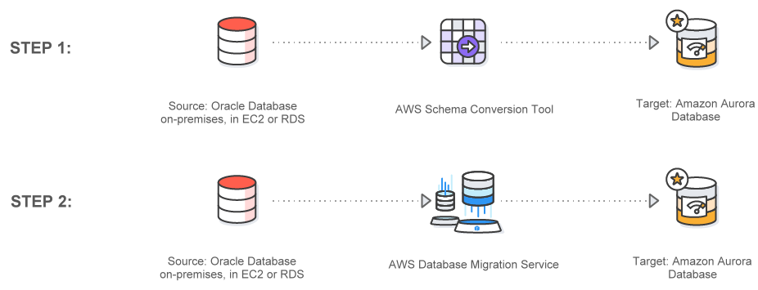
Database Migration Process

Slide 61

Thank You For Attending
We hope you found it interesting! A kind reminder to
complete the survey and tell us your thoughts about today’s webinar and how we can improve your webinar experience for you in the future

